Slide 1
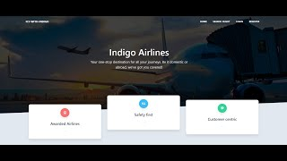
Fly
With
Indigo
Demonstration video
Link
All in one portal for fulfilling customer needs

Slide 2
Description
This project is a comprehensive flight maintenance and notification system designed for an airport, featuring a React-based frontend, a Python Flask API backend, and Kafka for real-time updates. This system aims to streamline communication between airport staff and customers, ensuring timely updates and efficient management of flight-related information. Administrators and staff can send notifications and broadcast messages, while customers can view real-time updates regarding their flight status, boarding passes, seat numbers, and more. The integration of Kafka ensures that these updates are promptly pushed to the frontend, providing a seamless and responsive user experience. Additionally, the system incorporates secure authentication protocols for both staff and customers, with the backend leveraging MongoDB for data storage and Node.js for socket management. This robust setup not only enhances operational efficiency but also significantly improves the customer experience by keeping them well-informed and engaged.

Slide 3
Implementation Details - Diagram
React JS (Frontend)
- Displays Data
- Uses Socket.io
Server (WebSockets)
- Manages Connections
- Emits Real Time Updates
Flask API (Backend)
- Sends notifications and broadcasts over kafka
- Provides authentication
Apache Kafka (Streaming Service)
- Topics
- Consumers
- Producers
MongoDB (Database)
- User data
- Flights data
- Bookings data

Slide 4
The pillars of strength- Tech stack
Flask Backend
React Frontend
Node.js Websockets
The app uses a flask API based backend which connects to MongoDB and at the same time, provides routes for broadcasting over Apache Kafka.
The app uses React and Tailwind for providing a dynamic front-end for users to easily access and understand the portal.
The socket.io library helps bridge the Apache Kafka to React based front end. Once the user connects to the websocket, they are looped in for real time updates.

Slide 5
List of features provided by the portal
User Sign Up
User Log In
Dashboard
Book a flight
Real Time Updates
Boarding
Any customer can easily sign up by entering their email address and setting up a password
Any customer, staff person or admin can easily log in via the same form and still end up on respective dashboards.
For each person, their dashboard has been customised to cater to their needs.
Any customer can easily search and book a flight. The flight can be searched by arrival or departure too.
The admin can easily send either a notification to particular set of people, or can broadcast to all the customers in the database
The staff can board or cancel the passenger as per their own request. An email notification for the same will be sent too.

Slide 6
The “Role” based division
Admin
Staff
Customers
Assigns other employees the role of admin or staff. Sends notifications to particular flights and broadcasts announcement to whole user database.
Registers new flights to database and boards passengers. Allows passengers to cancel their boarding.
Register themselves on the portal to search flights and book tickets. They receive updates both by email and on the portal, keeping them informed about their flight.

Slide 7

Apache Kafka & Websockets
Apache Kafka, which is massively scalable, as it allows the data to be distributed across multiple servers, is the best choice for sending out notifications and broadcasts.
Thus using Flask API, the routes are configured to send out data over Kafka topics named ‘notifications’ and ‘broadcasts’.
These events are then listened for by websockets, which are capable of reading the data from Kafka topic and further sending it over the websocket to React based frontend.

Slide 8

Emailing notifications and updates
The Email.js is a powerful library, which allows us to customize our own templates and setting up our own email service. The portal uses email.js to send mails to all passengers whenever announcements are made related to their particular flights. Other than that, whenever the staff marks the passenger as “boarded” or “cancelled”, the passenger received a mail, conveying the updated status of their travel booking.

Slide 9
Click here for video link
Project Demo
A slideshow of screenshots from the portal

Slide 10
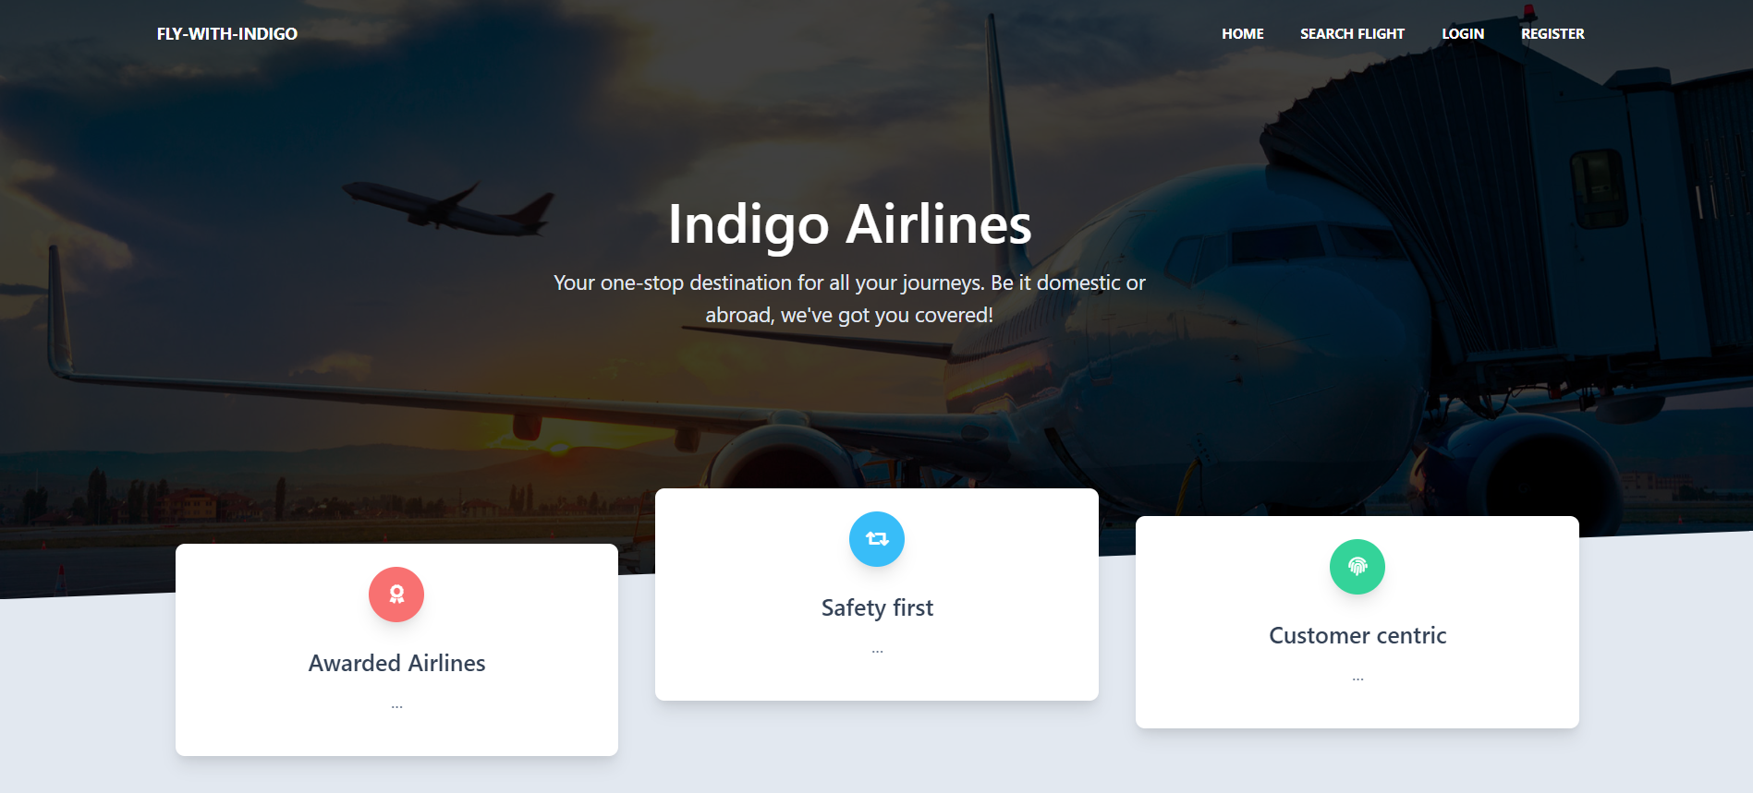
Landing Page

Slide 11
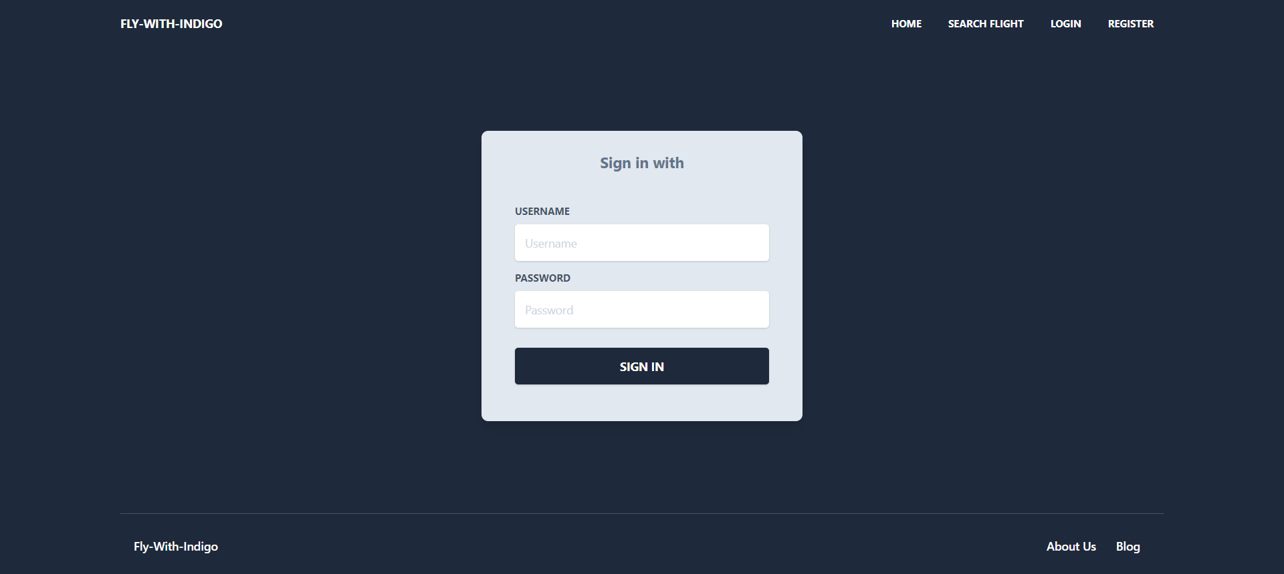

Slide 12
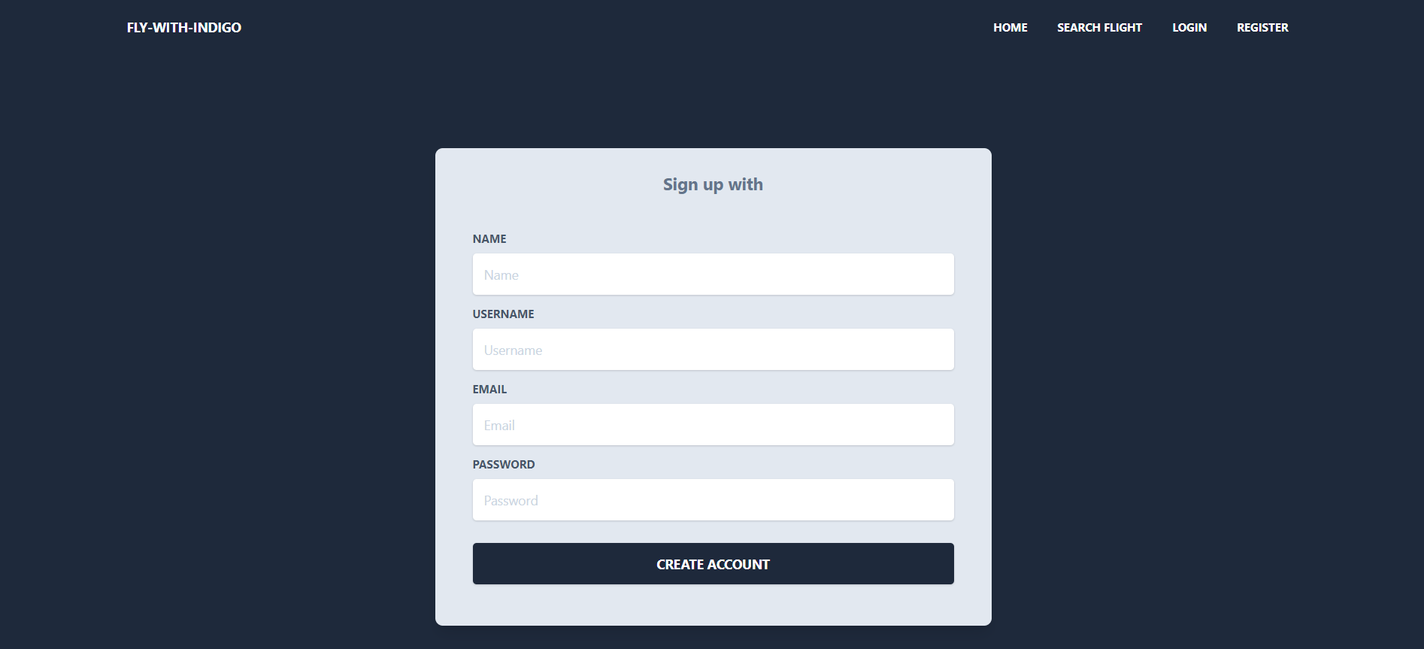

Slide 13
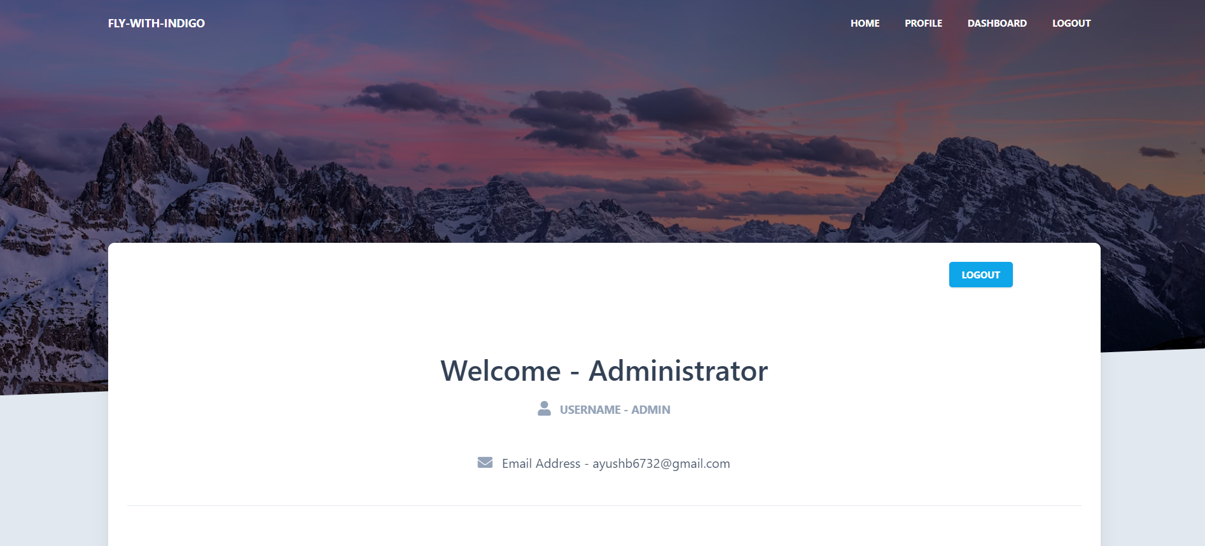

Slide 14
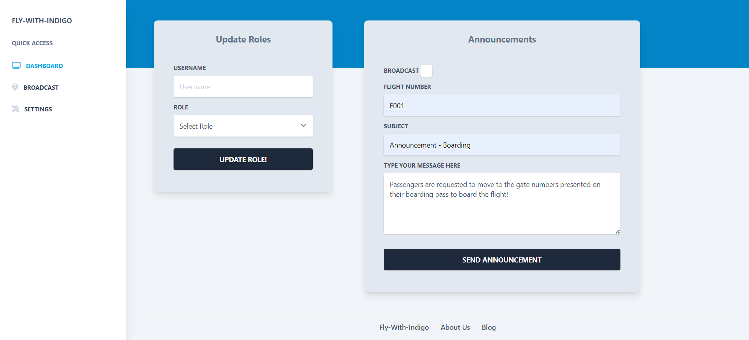

Slide 15
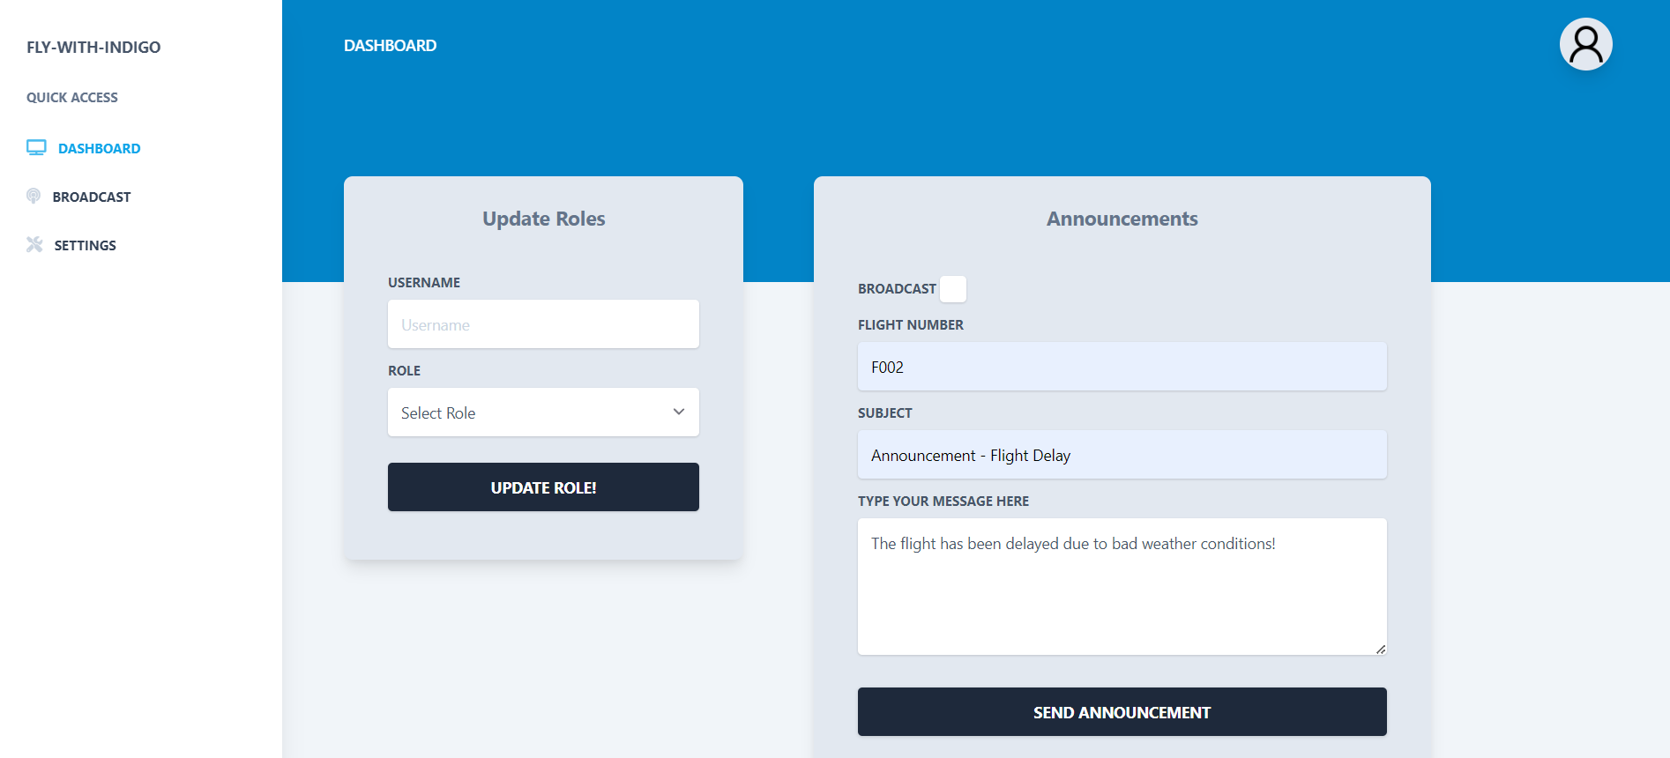

Slide 16
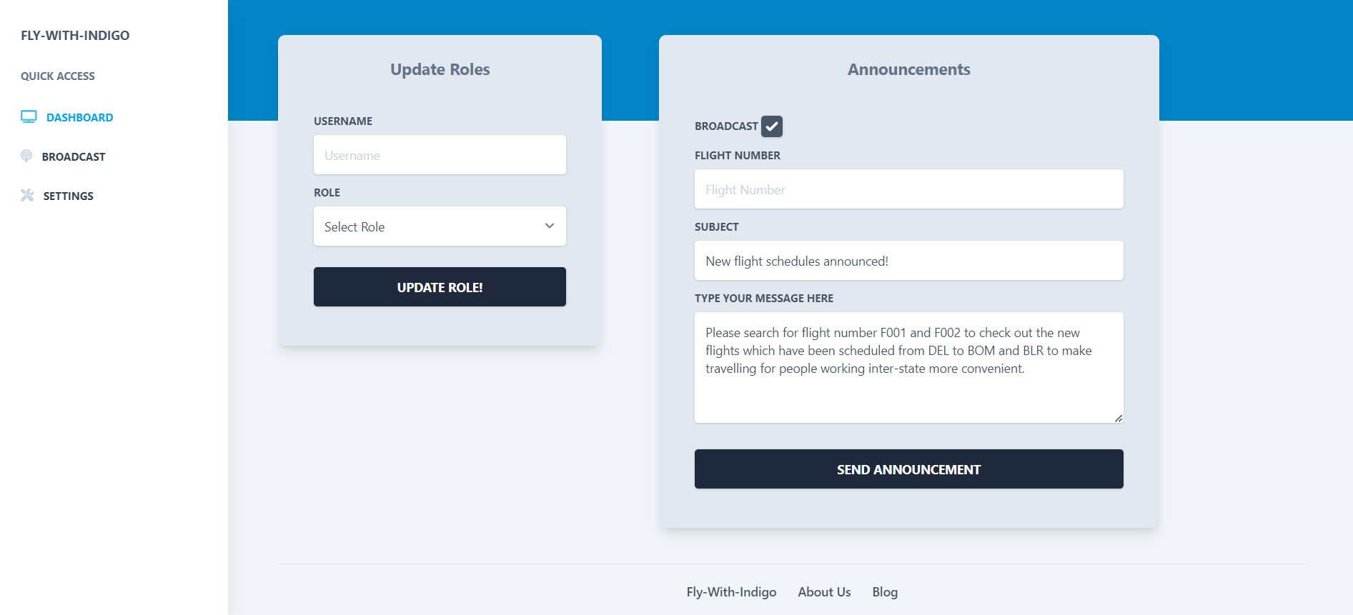

Slide 17
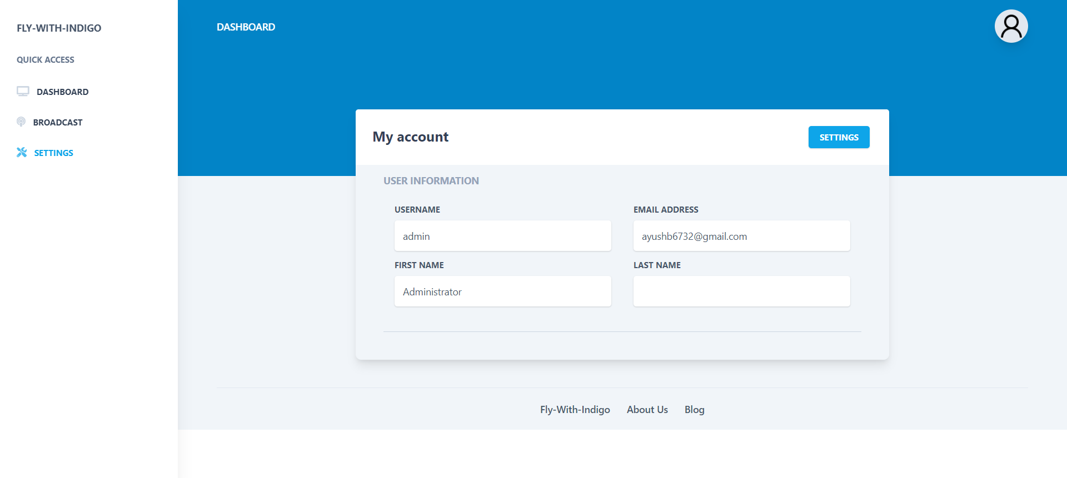

Slide 18


Slide 19
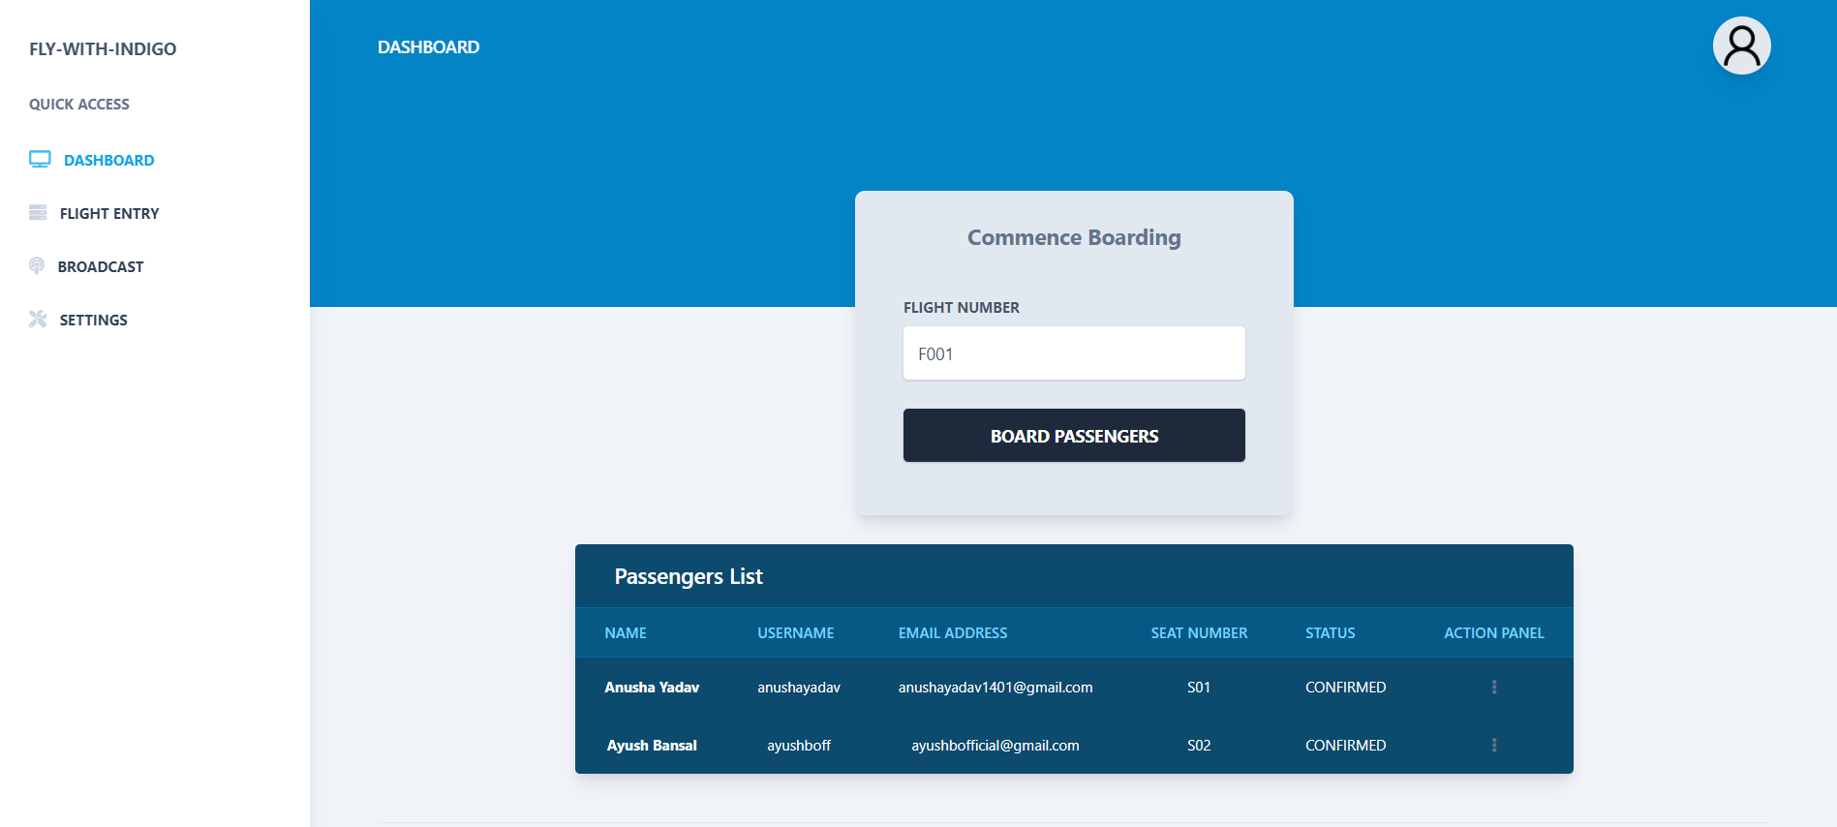

Slide 20
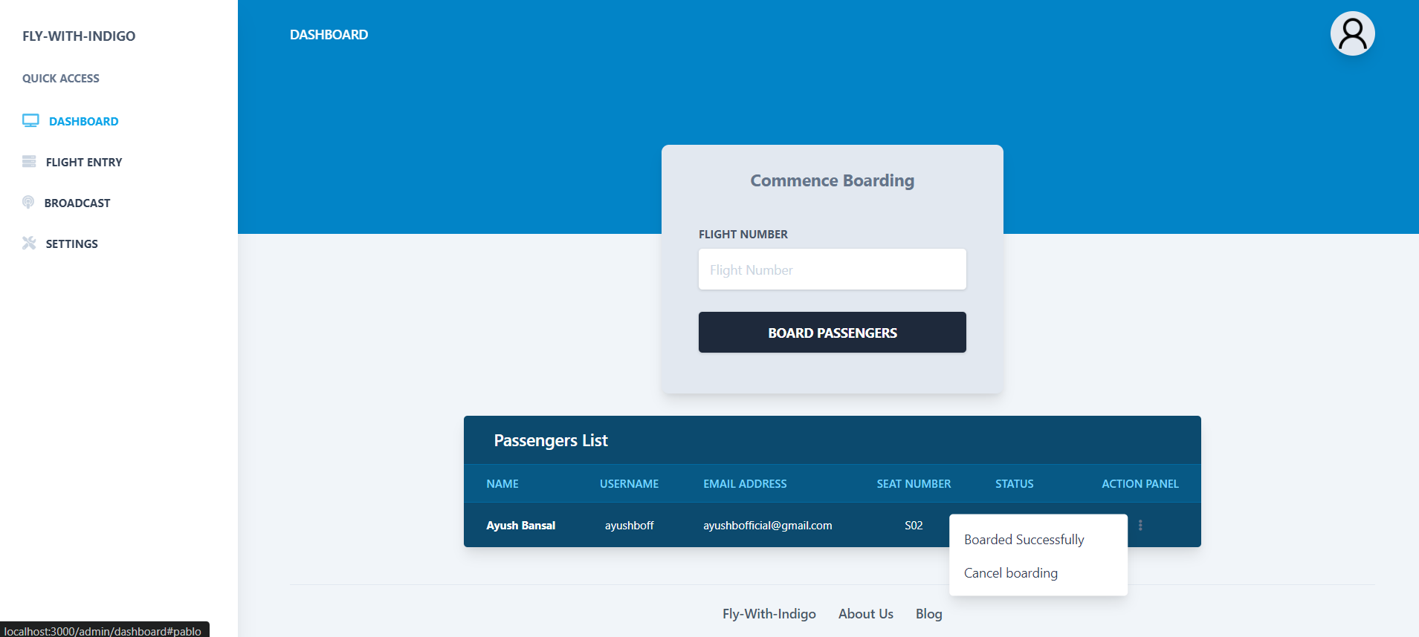

Slide 21
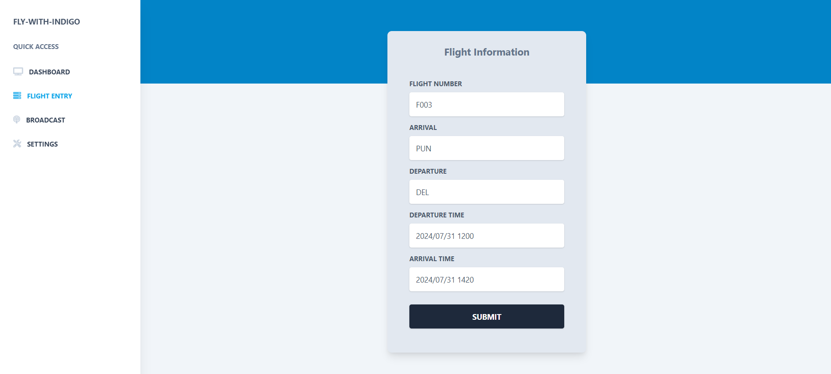

Slide 22
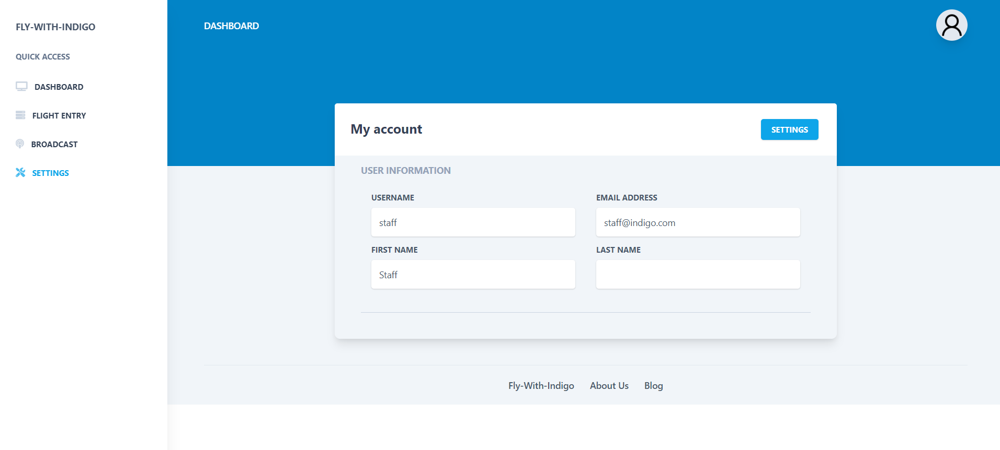

Slide 24


Slide 25
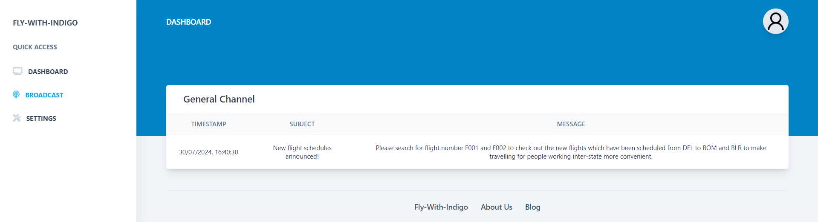

Slide 26
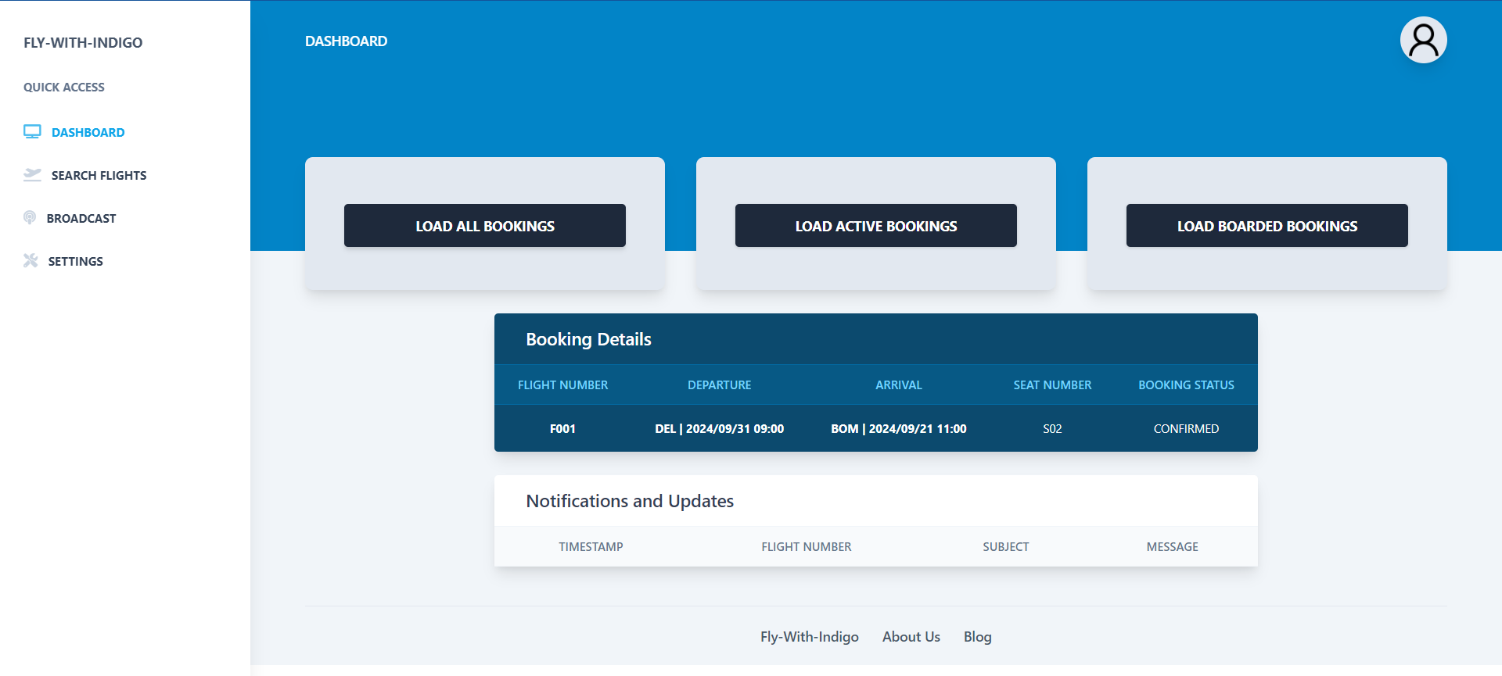

Slide 27
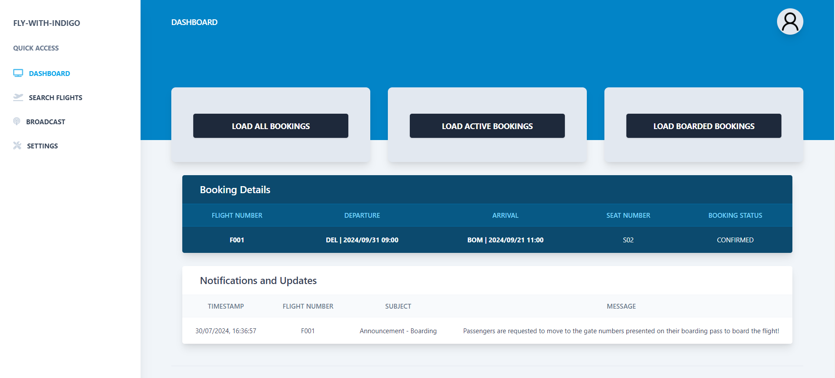

Slide 28
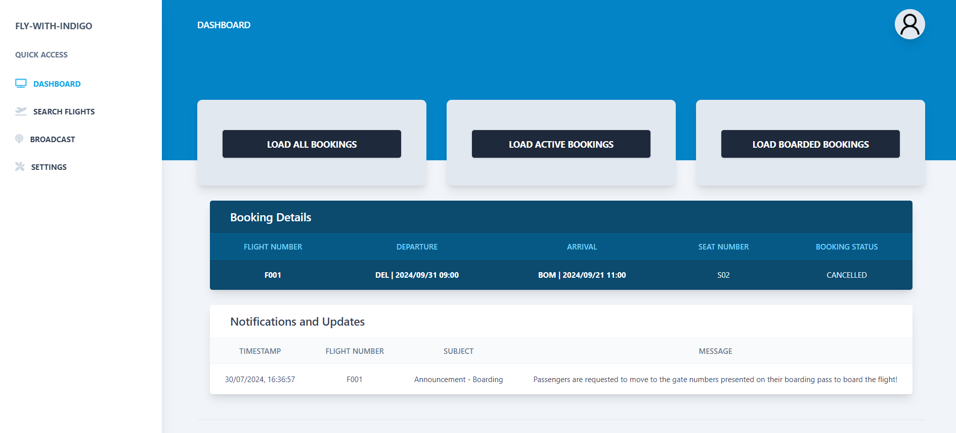

Slide 29
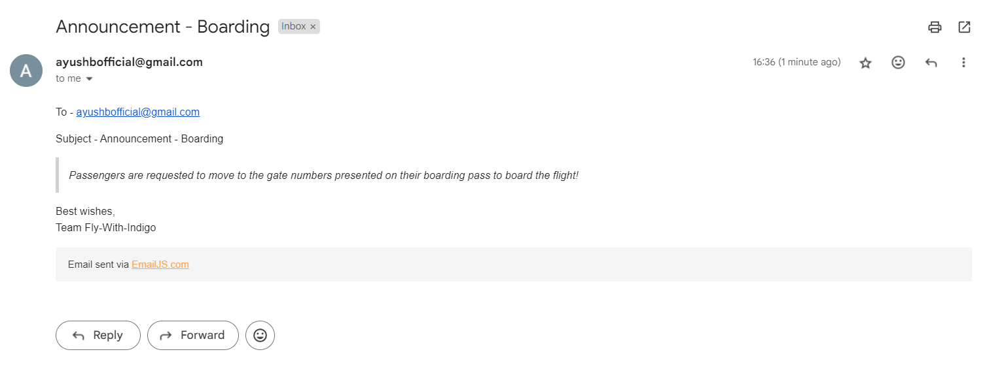

Slide 30
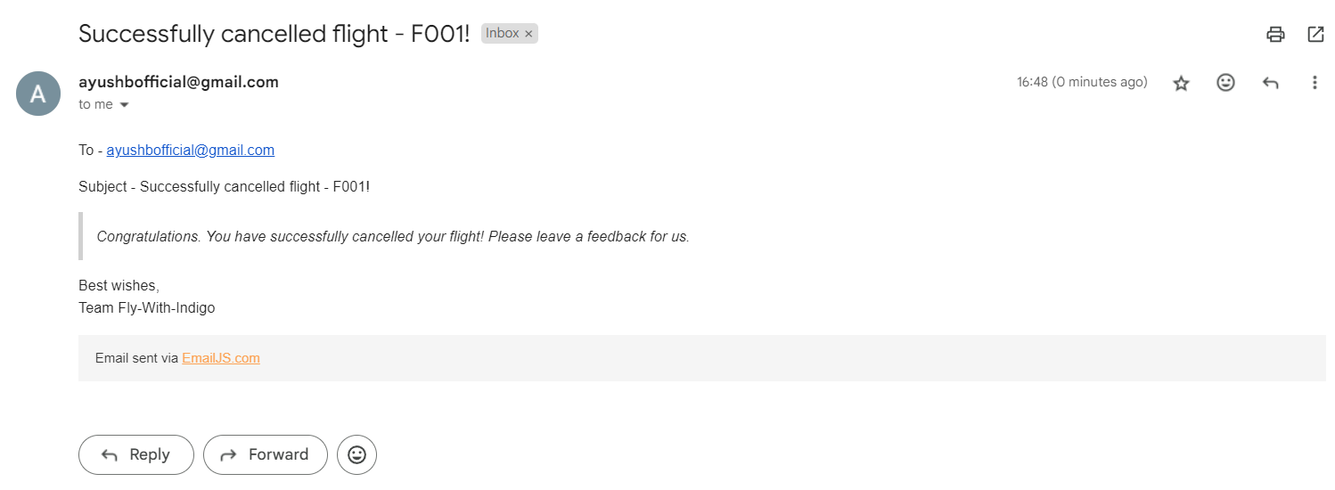

Slide 31


Slide 32


Slide 33
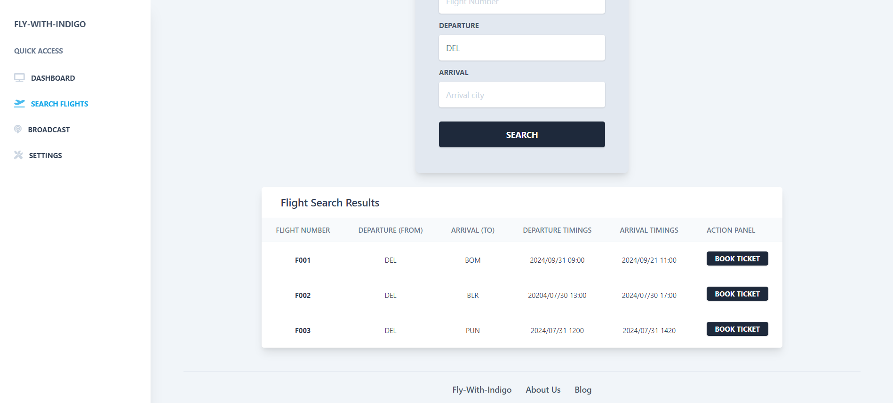

Slide 34
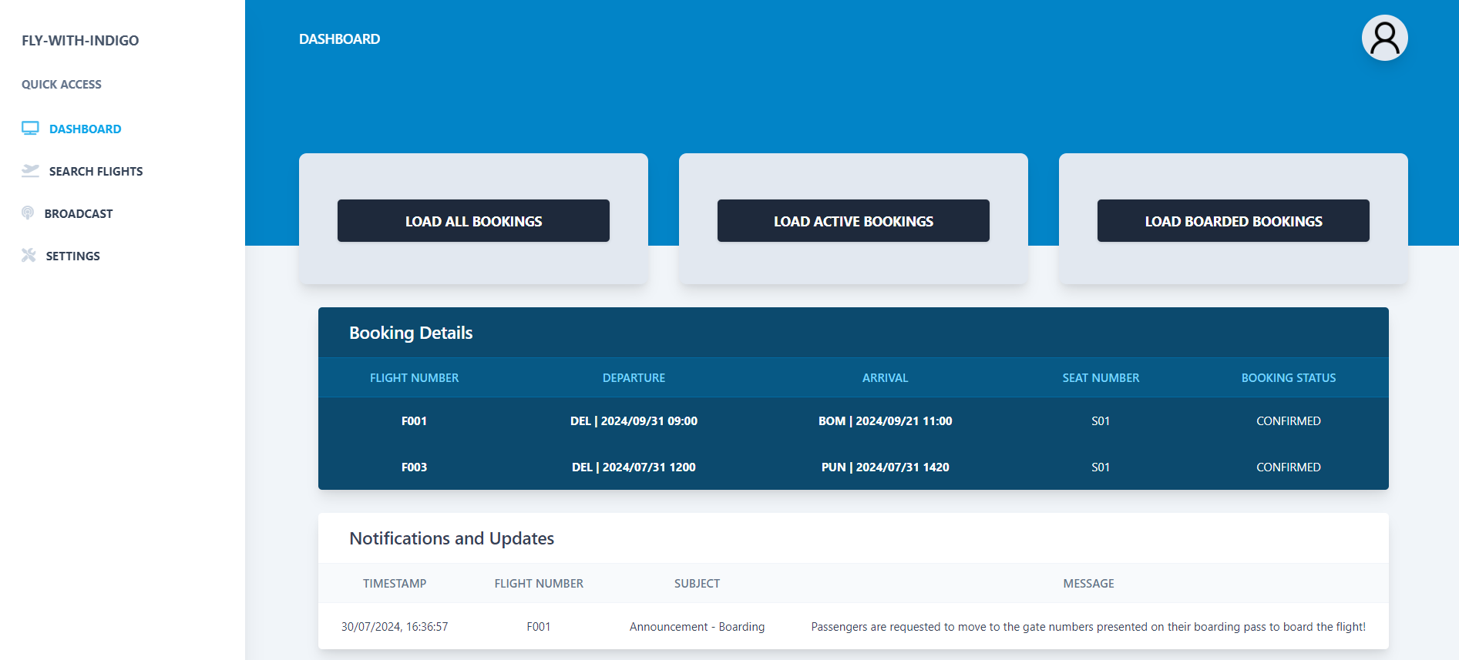

Slide 35
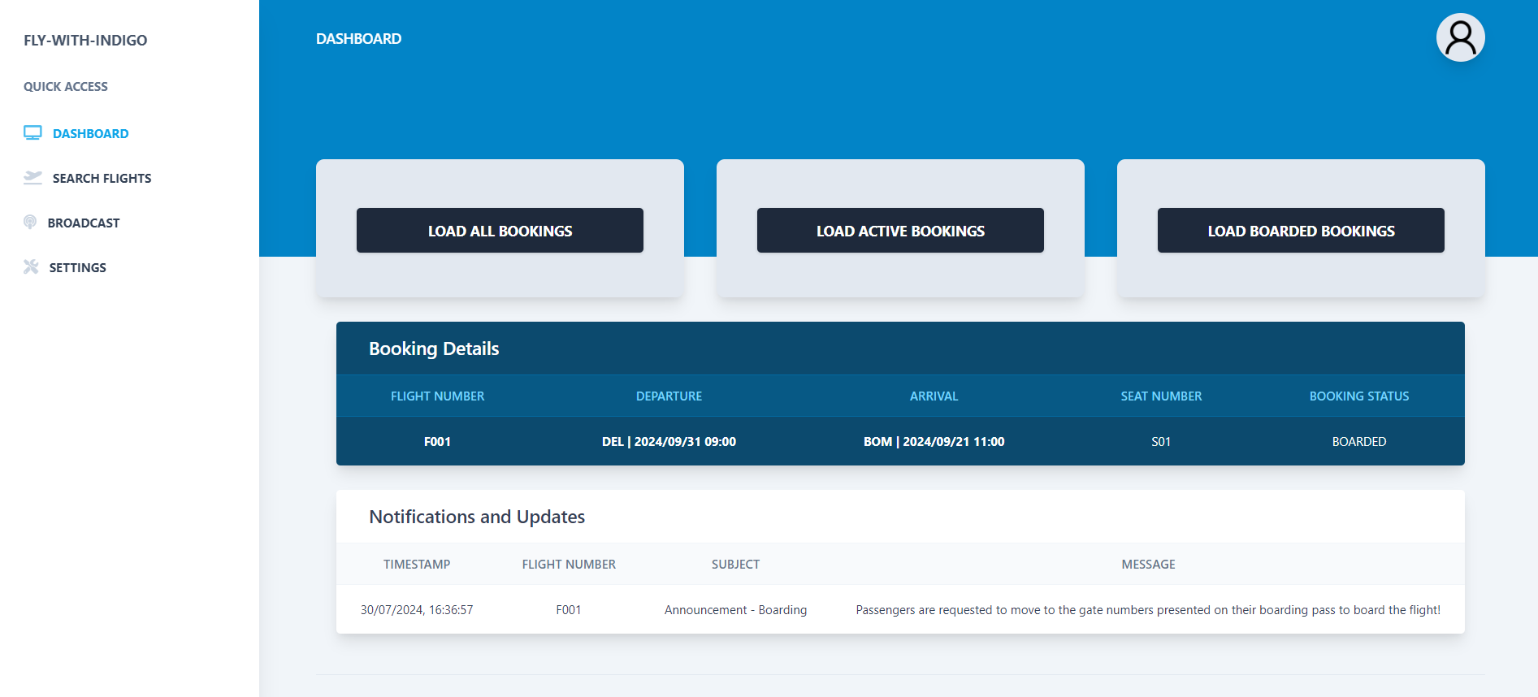

Slide 36
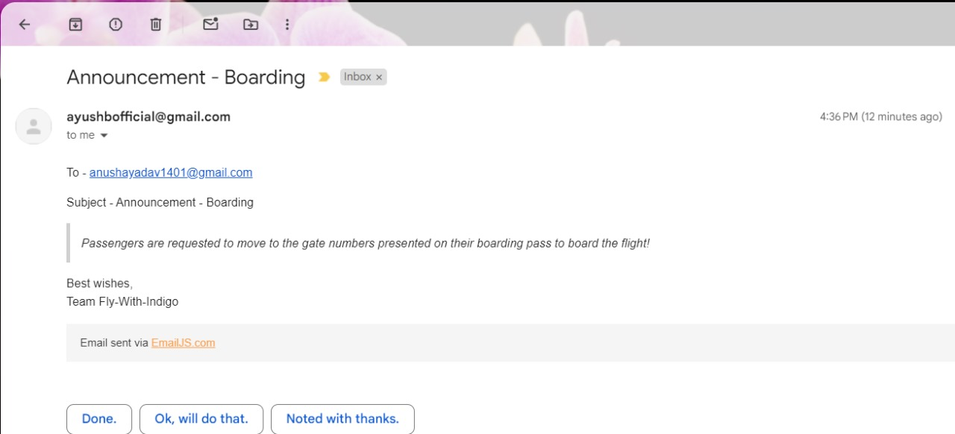

Slide 37
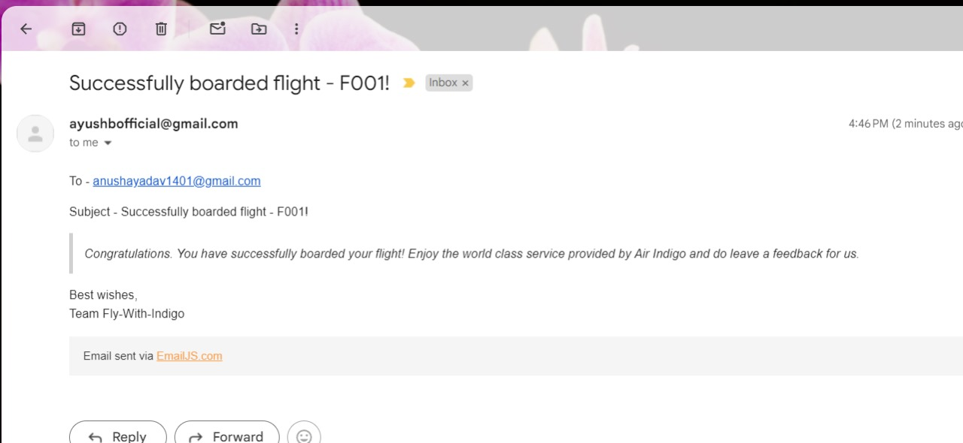

Slide 38
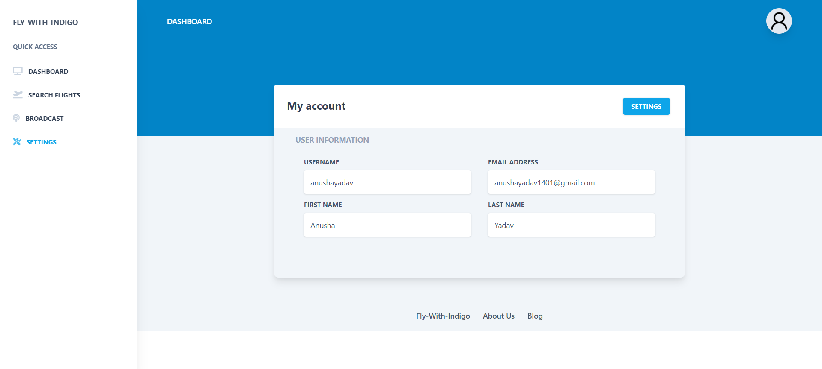

Slide 39
Thank You!
Contact me - ayushb6732@gmail.com

